Slide 1


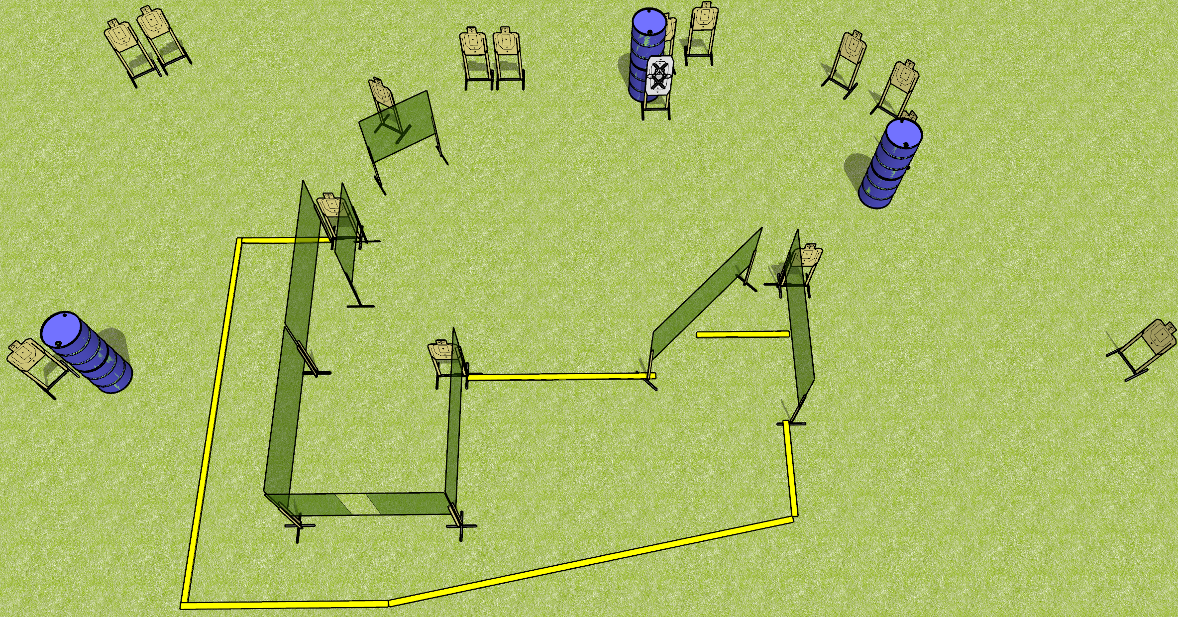
 | Dothan Gun Club – USPSA Match Off Week Course Designer : Drew Coleman
Round Count 30 rounds 15 USPSA
Equipment List 13 wall feet 2 medium fault lines 16 USPSA targets (15 + 1 NS)

Slide 2
Off Week
Written Stage Briefing
Off Week is a 30 round, 150 point, Comstock course of fire. There are 15 USPSA targets. The best 2 hits on paper will score. The start signal is audible.
Handgun start position is inside the shooting area, wrists below belt. Handgun is loaded and holstered.
PCC start position is inside the shooting area, stock on belt. Loaded carbine is held with both hands,
On start signal, engage targets as they become available from within the shooting area.

